Slide 1
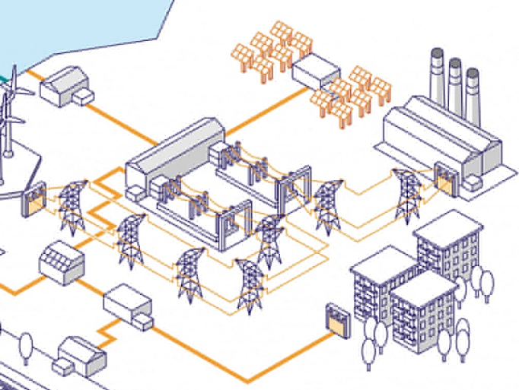
Experiments on Unipolar, Polar and Bipolar Line Encoding Schemes
TEAM Kaabil
Anudit Nagar
E18CSE024
Abhimanyu Banerjee
E18CSE005
Computer Science Engineering Department, Bennett University, Greater Noida, U.P.

Slide 2

Introduction
1
2
3
During Transmission of data from source to destination the transmitting signals may undergo attenuation and distortion.
Need to match the properties of transmitted signal as per the communication media for which digital data can be converted into digital signals.
Various Uni-polar, Polar and Bi-polar line encoding techniques are used for digital data to digital signal conversion.

Slide 3

Objectives
1
Implementation of various Line encoding techniques through a Virtual lab experience.
Providing a simple and optimized interface so that it can be used by people who are just starting to venture out in the field of signal encoding
2

Slide 4
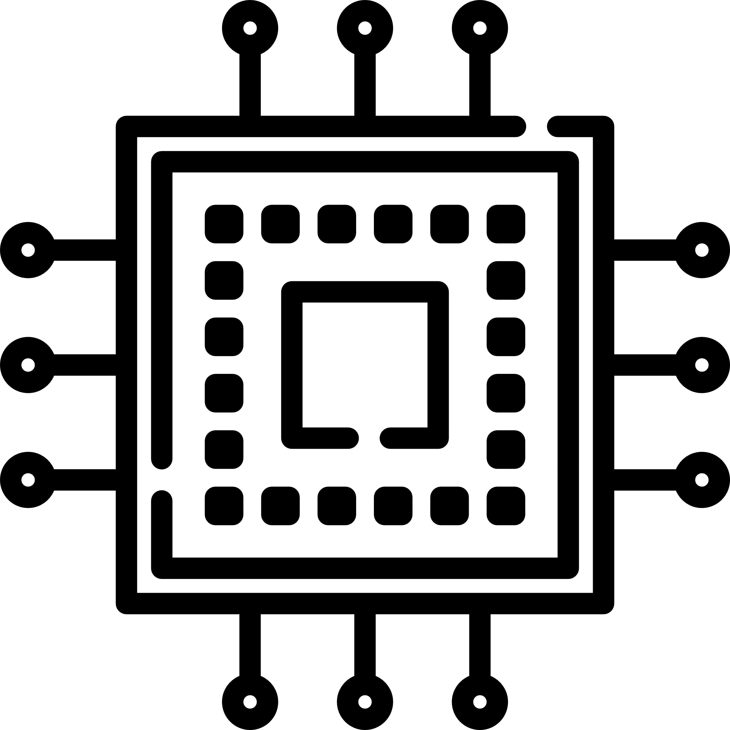
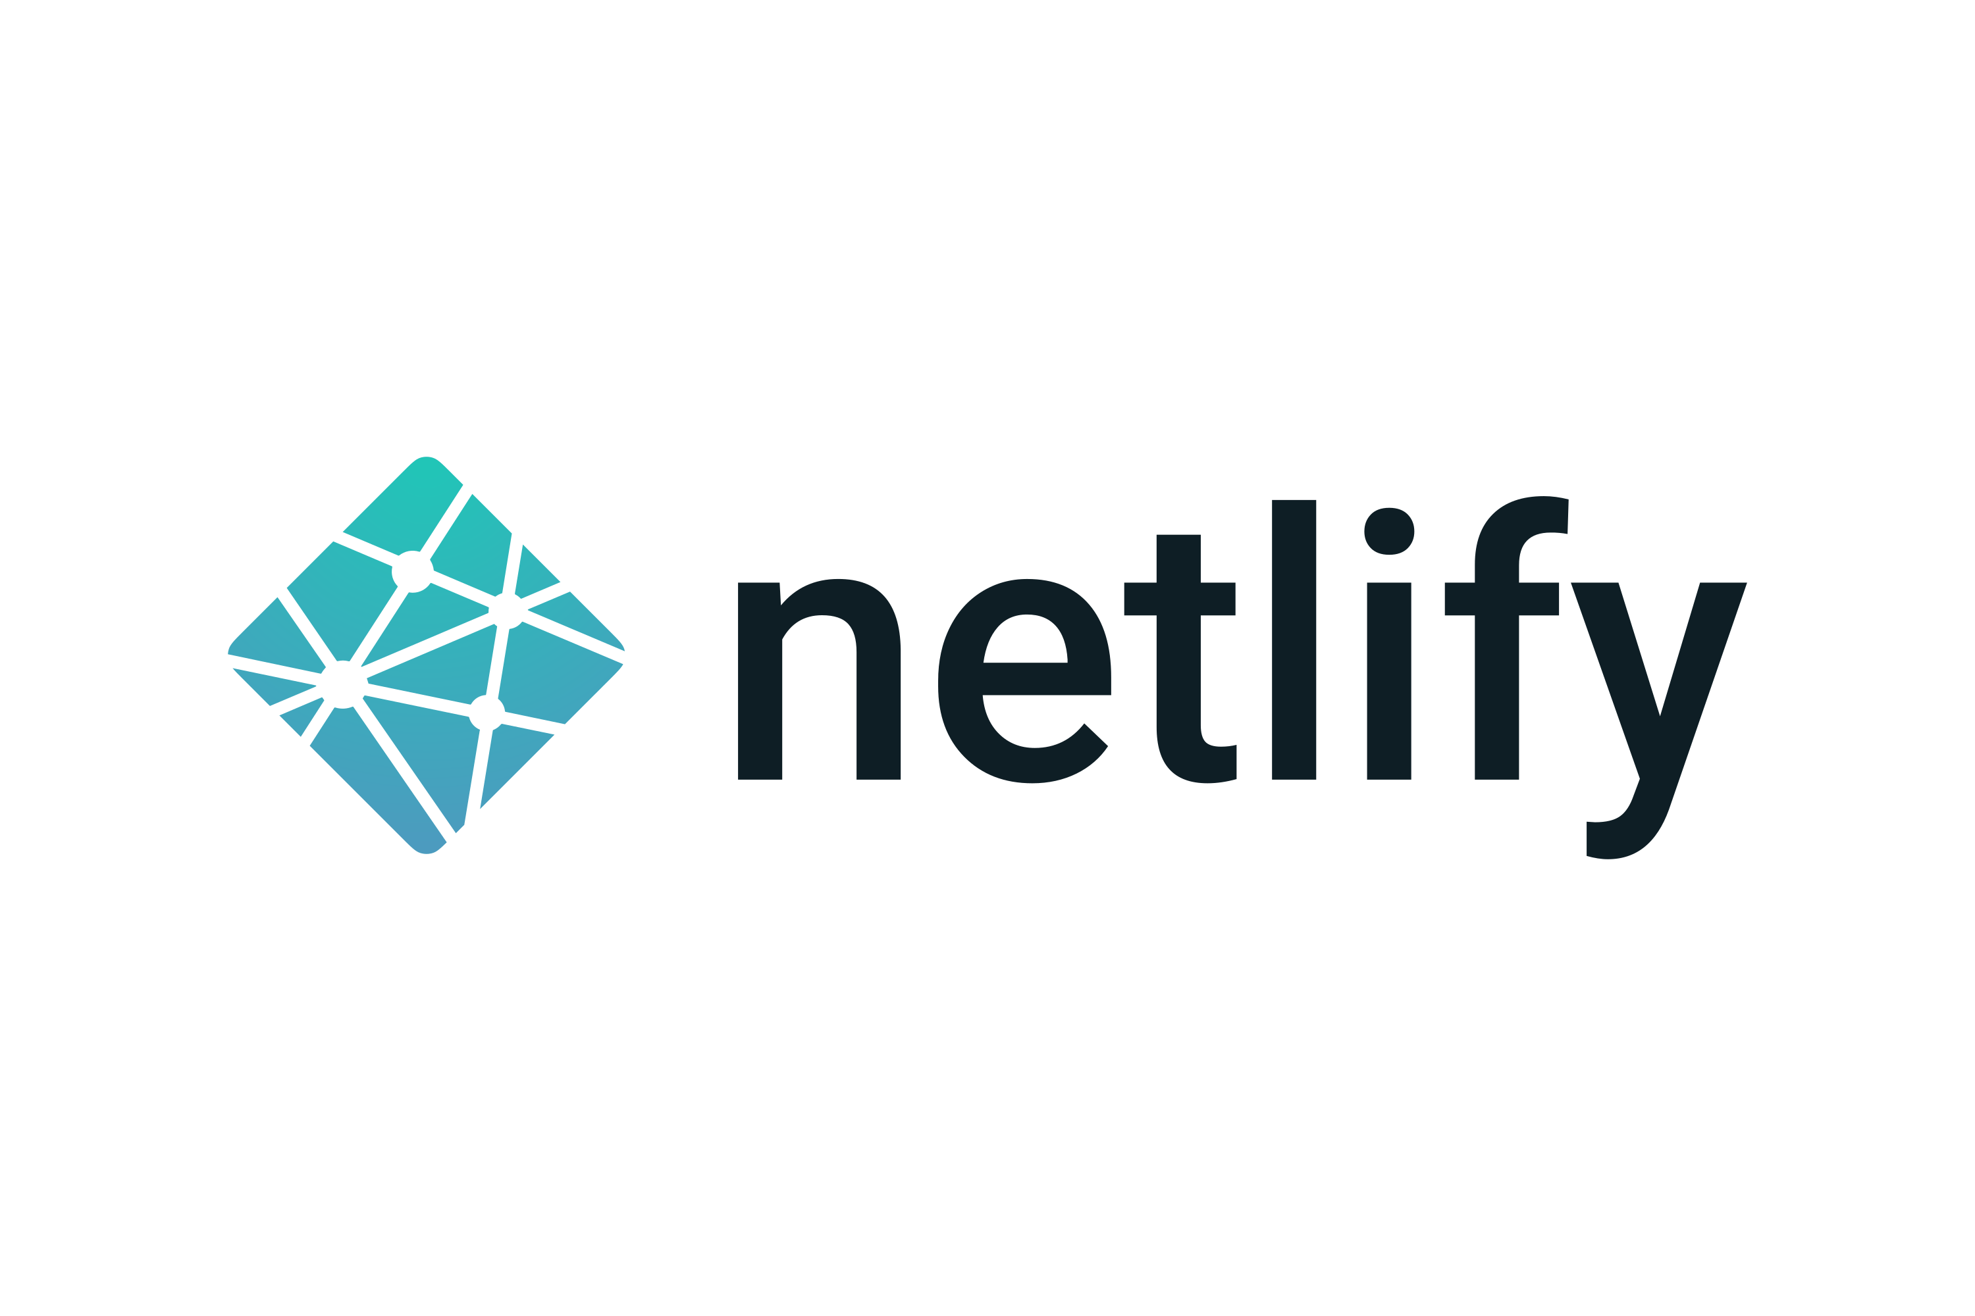
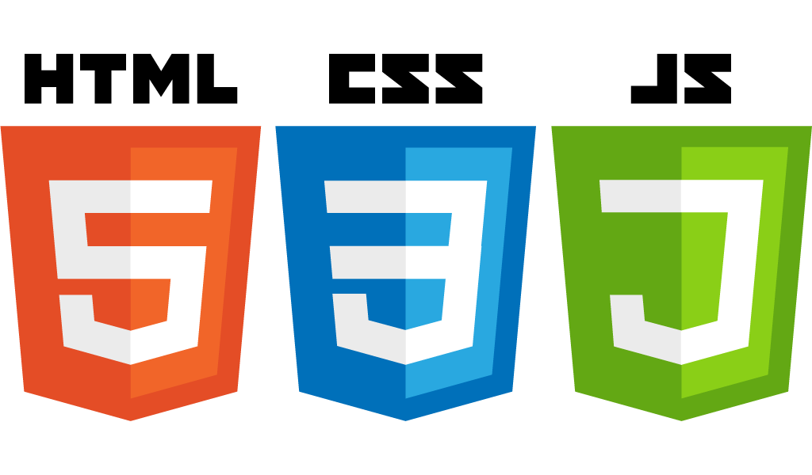
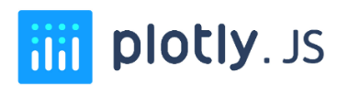
Technological Resources Used
Visual
Representation
Project
Stack
Deployment
Strategy

Slide 5

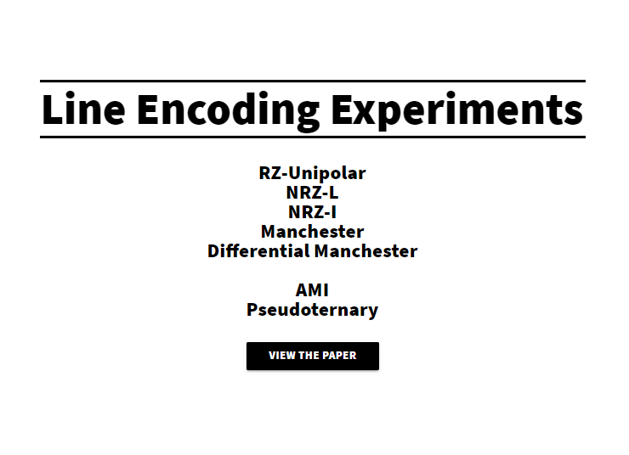
Methodology
When the user starts the application, they are presented with a central dashboard with various experiments listed that are available to perform. Here they can choose whichever encoding scheme they would like to experiment with and the application will take them to a dedicated space where the experiments for that specific encoding can be carried out.

Slide 6
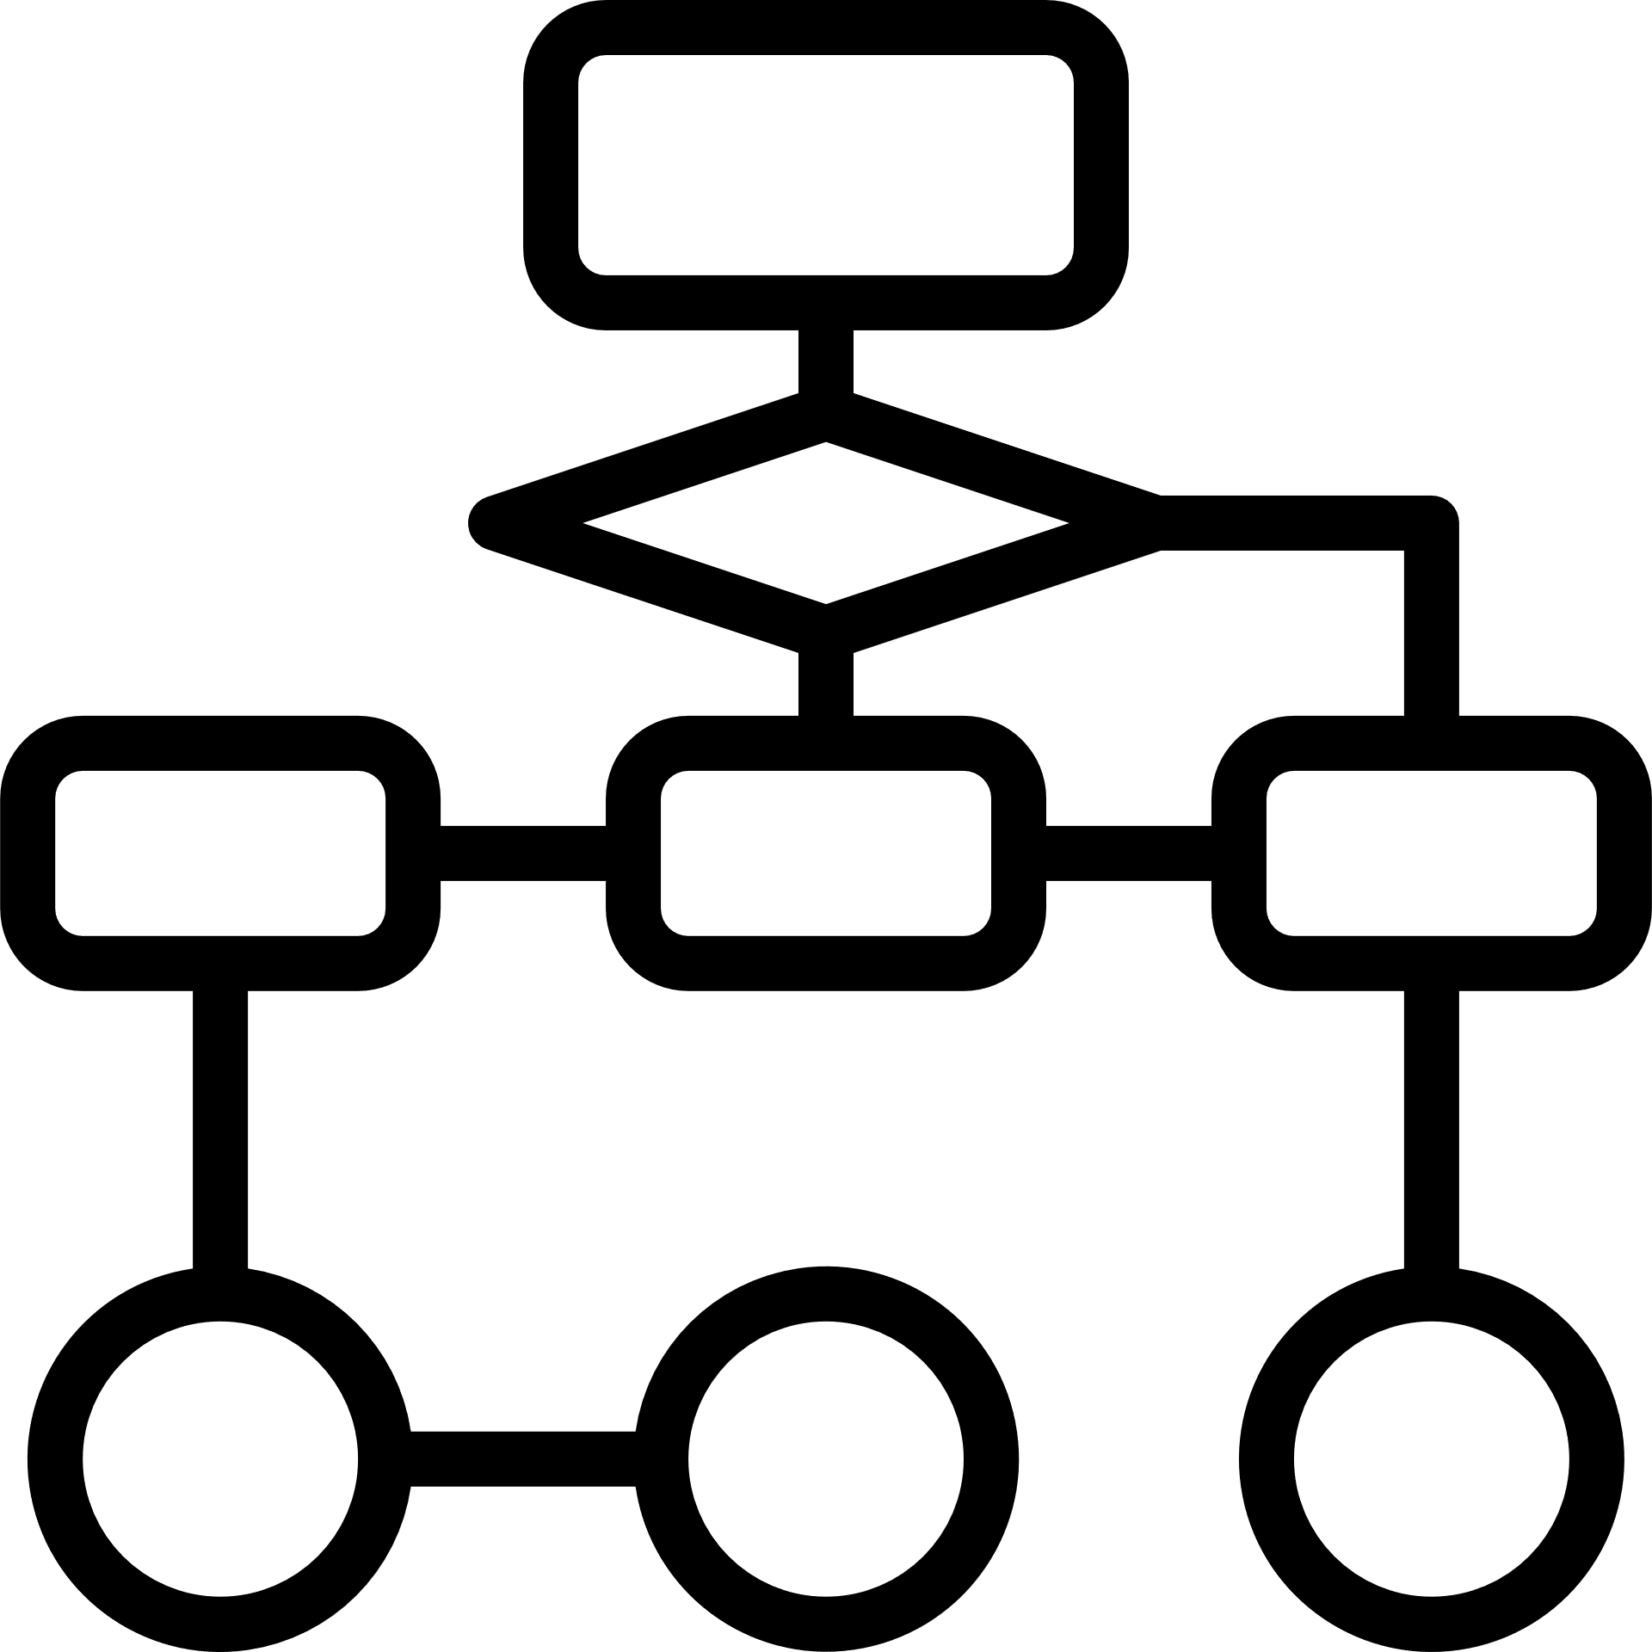
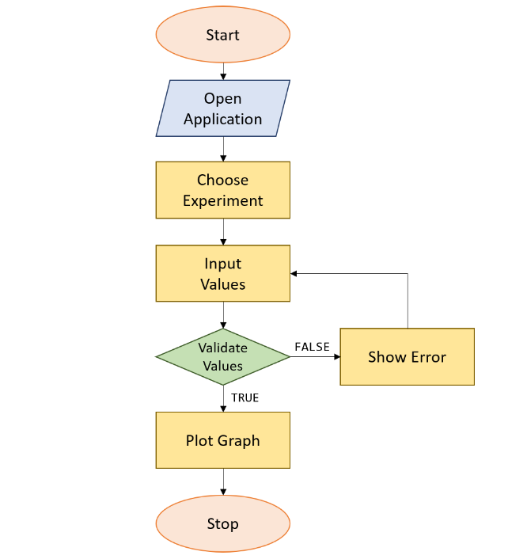
Flow
of the
Project

Slide 7
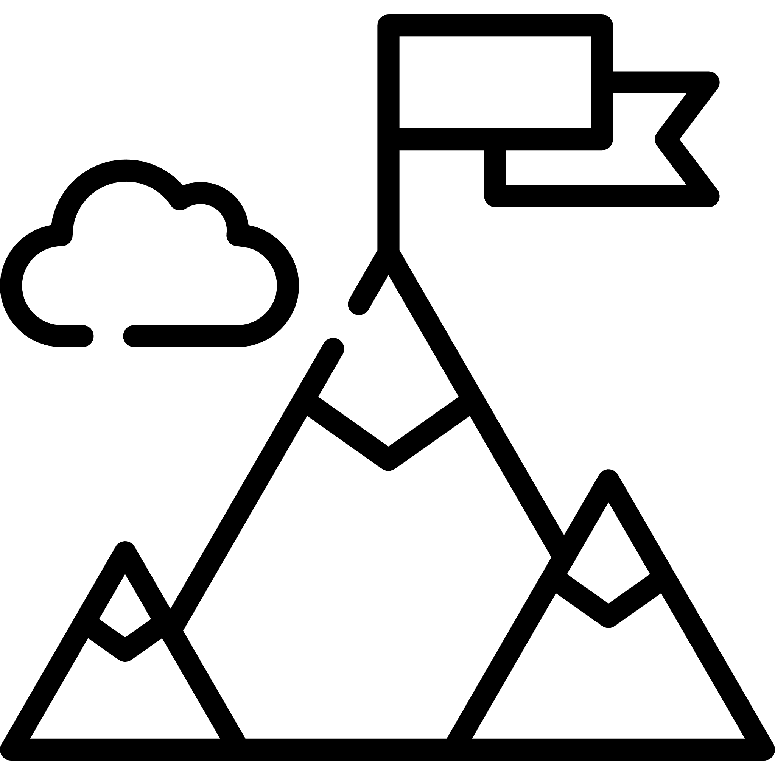
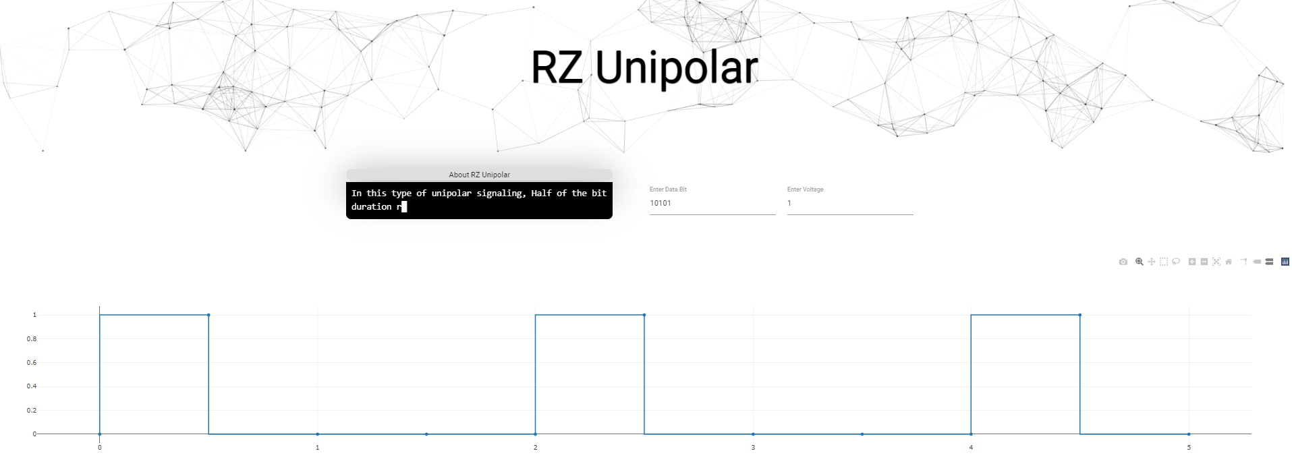
Results Achieved
Performance improvements and cross platform compatibility allowing anyone with an internet connection to perform experiments online using a virtual lab experience.
It removes the hassle of installing dependencies and configuring a development environment making the platform accessible to everyone.
It offers advanced features like live updates and in-browser voltage control

Slide 8
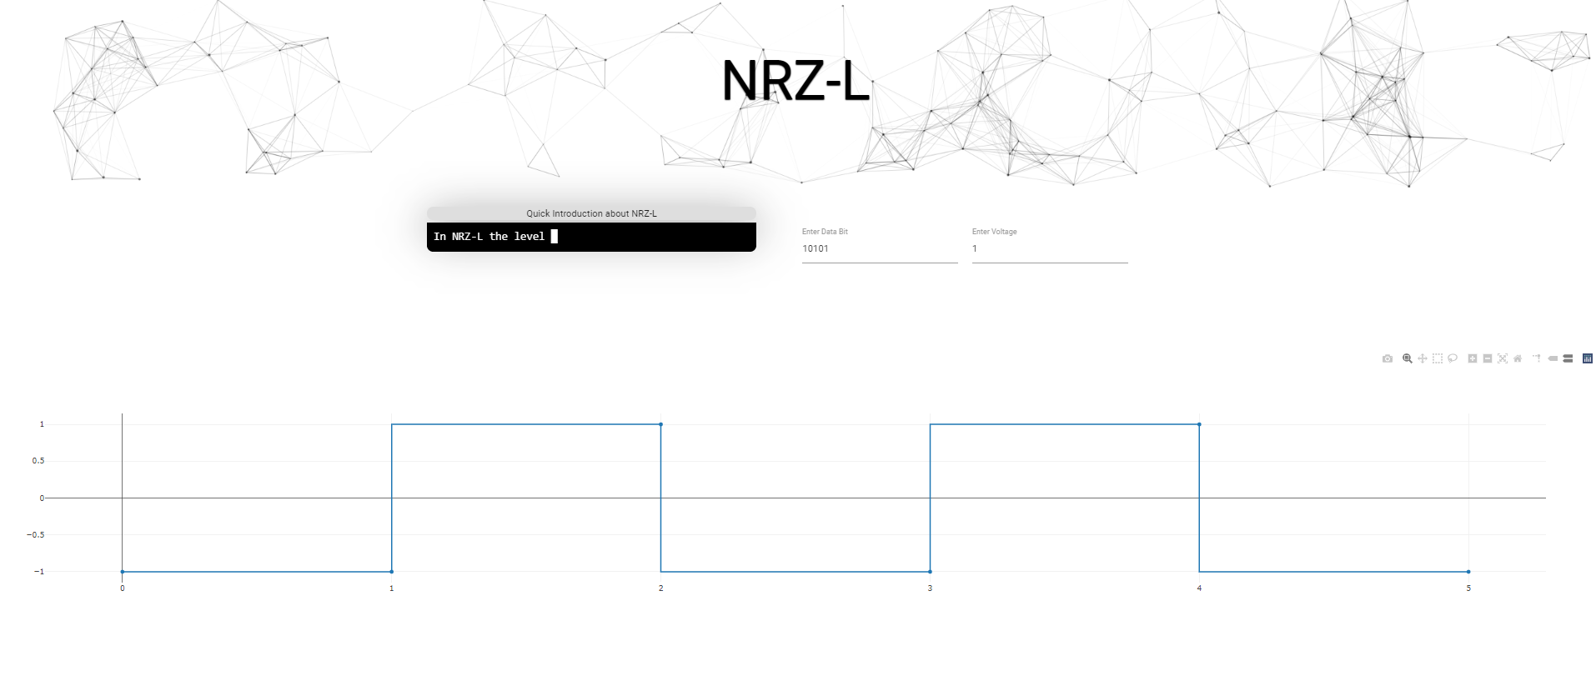
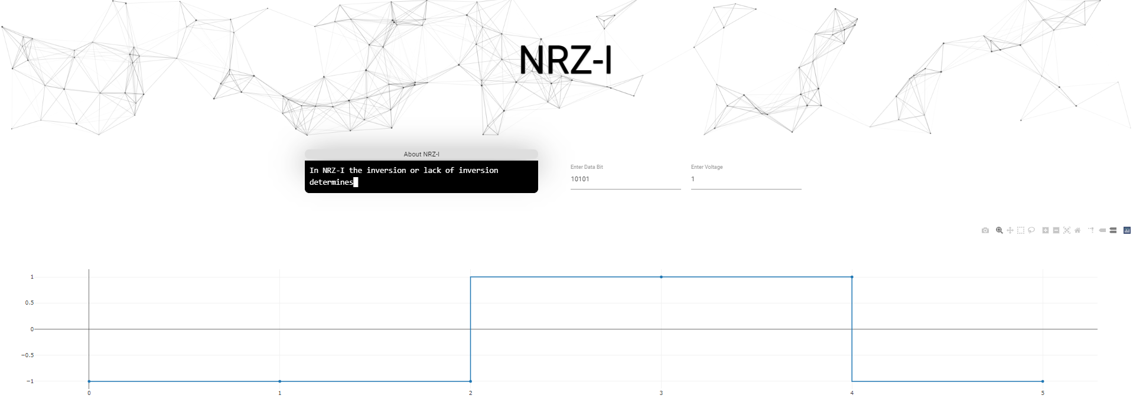
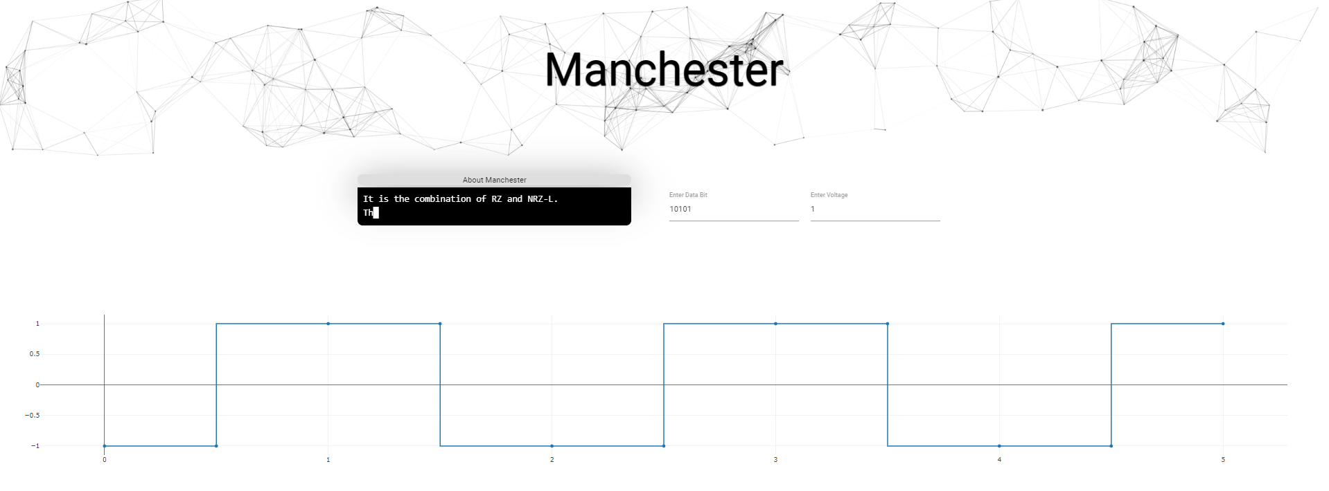
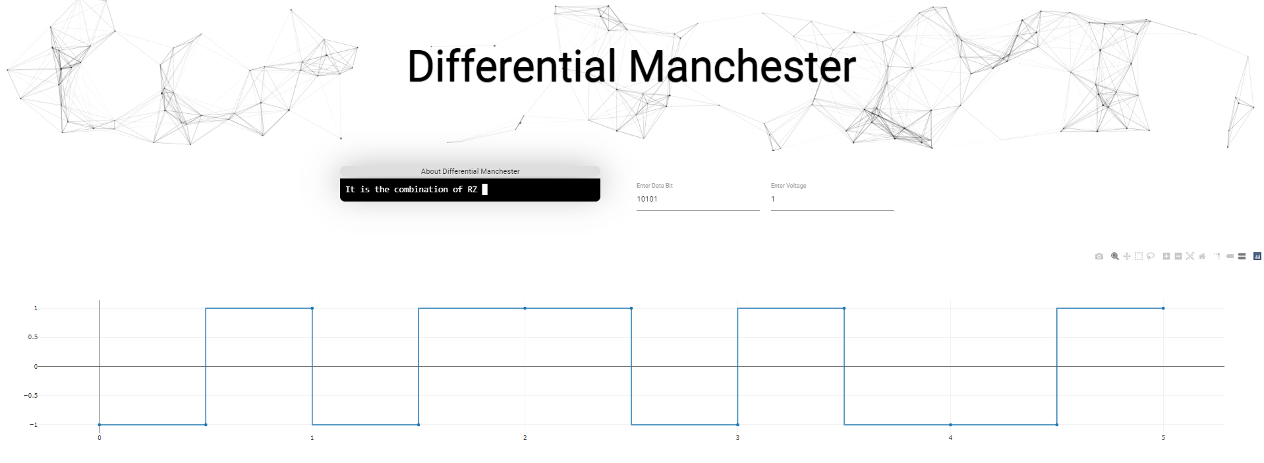
Results Achieved

Slide 9
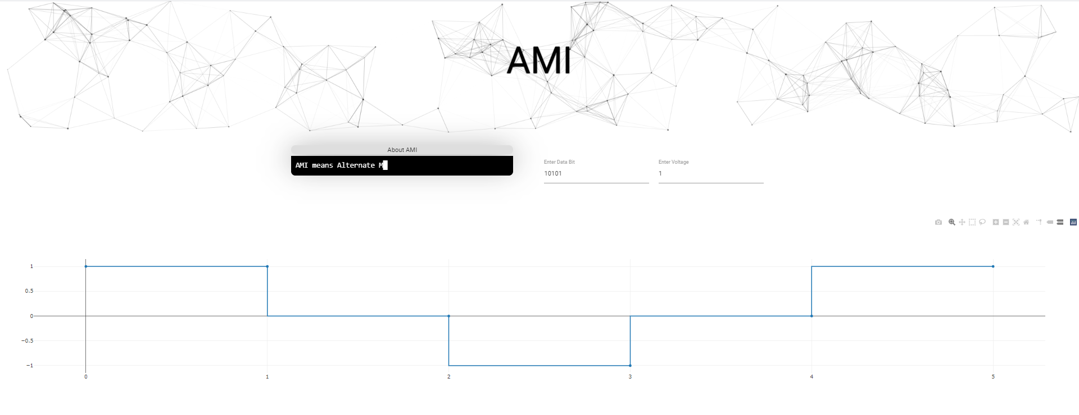
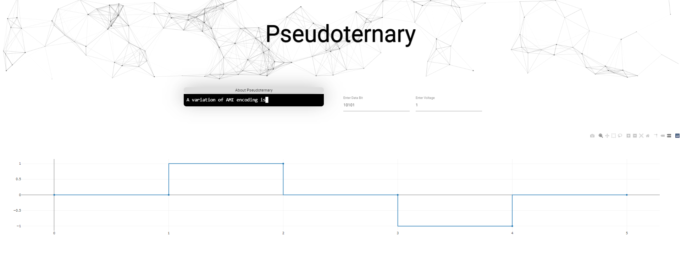
Results Achieved
Bipolar Encoding Schemes

Slide 10
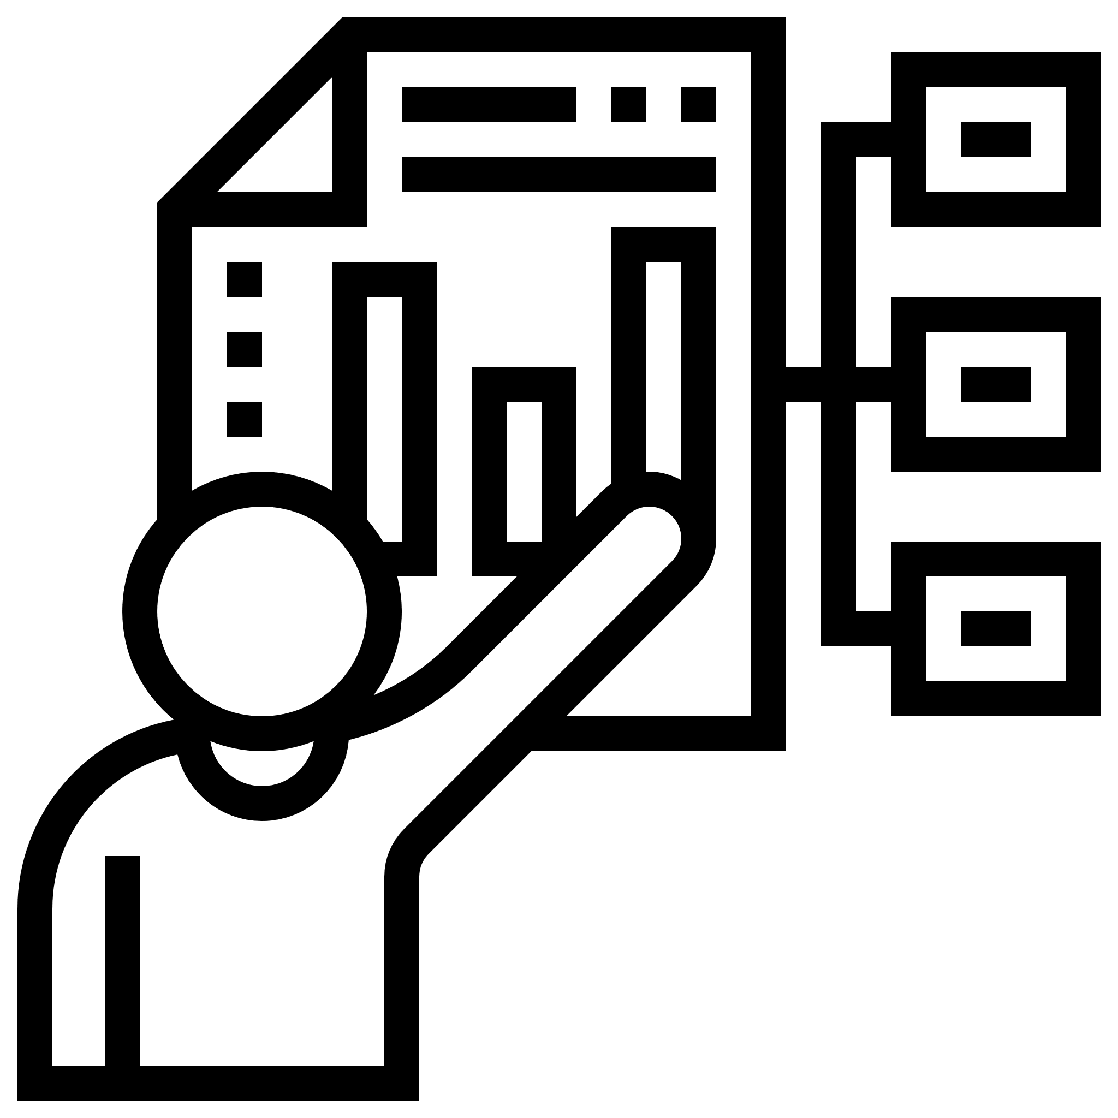
This project showcases an advanced mechanism for line encoding experimentation
It brings features like cross-platform compatibility, live-updates, dynamic voltage control, modern plotting libraries with granular control of generated graphs and the ability to save results for future use.
Conclusion
These advanced features are presented in a simplistic manner to make them simple and accessible by everyone.
These advanced features are presented in a simplistic manner to make them simple and accessible by everyone.

Slide 11

1
https://www.arjournals.org/index.php/bjdmn/article/view/264
2
https://ieeexplore.ieee.org/document/7934310?denied=
References
3
http://sustech.edu/staff_publications/20140424053538550.pdf
4
http://iosrjen.org/Papers/vol5_issue2%20(part-4)/D5242023.pdf

Slide 12

Thank You

